Slide 1
MM’21 Grand Challenge (GC)
ShengMing Tang

Slide 2
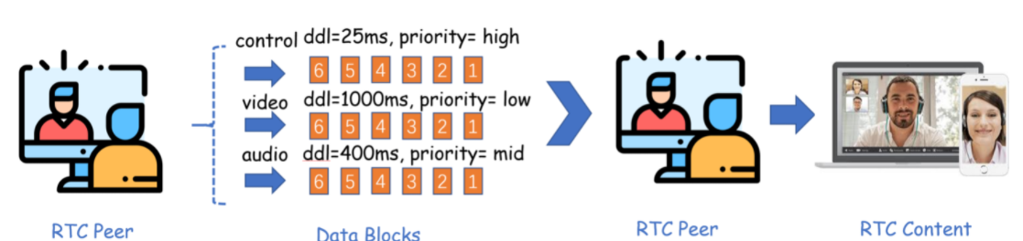
Introduction
GC web
Real Time Communication (RTC) application are popular
Online conferencing
Control (commands, reponse ASAP)
Video (large b/w consumption, stalling is tolerable)
Audio (annoying if sounds are not smooth)
Delay senstitive multimedia challenges
Meet deadline requirements
Can we send everything out once a block is available at highest rate?

Slide 3
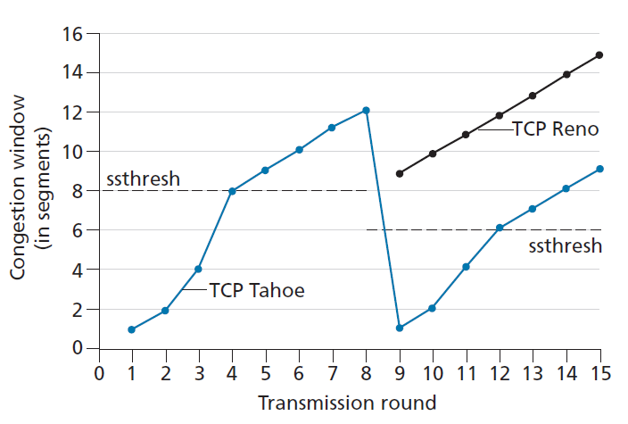
Introduction
Transmission
Application data are in unit of blocks with different priority
Control (high, priority-0)
Video (low, priority-1)
Audio (middle, priority-2)
Blocks are divided into packet to fit into lower network layers
Congestion Control
Send at unlimited speed will congest the link along the way
Congested link will introduce packet losses
Retransmission, Fast recovery
Miss a deadline

Slide 4
Introduction (cont’d)
Objective
Serve highest possible QoE, which is composed of
Priority
Meet the deadline
Design congestion control (CC) algorithms
Which block to send
Congestion window control (if your alg. is congestion window based)
At what speed

Slide 5
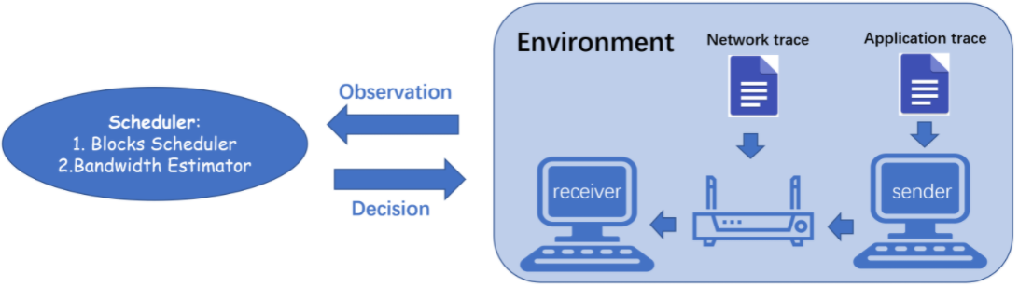
Simulation Platform
Platform
Network trace
Network condition record which can be replayed
Application trace
Block record which also could be replayed
Use the two traces to replay different scenarios

Slide 6
Task description
Block scheduler
select which application block to send
Bandwidth estimator
bandwidth estimation
congestion controll triggered on packet ACK/loss/sent

Slide 7
Function Explained
def select_block(self, cur_time: float, block_queue: list) -> int:
return block index to be sent relative to the block_queue
def on_packet_sent(self, cur_time: float) -> dict:
called on every packet is sent
state update
return {“cwnd”: int, “send_rate”: float}
def cc_trigger(self, cur_time: float , event_info: dict) -> dict:
called on packet ack-ed or droped
state update (return in the same form as on_packet_sent(...))
Examples are here.
TCP Reno

Slide 8
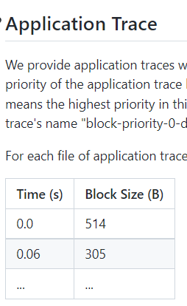
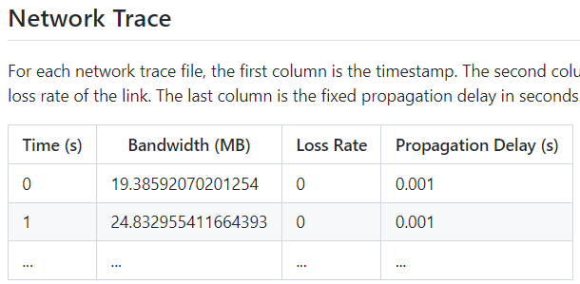
Dataset
Open dataset (on the same Github)
Test dataset will be open near the deadline

Slide 9
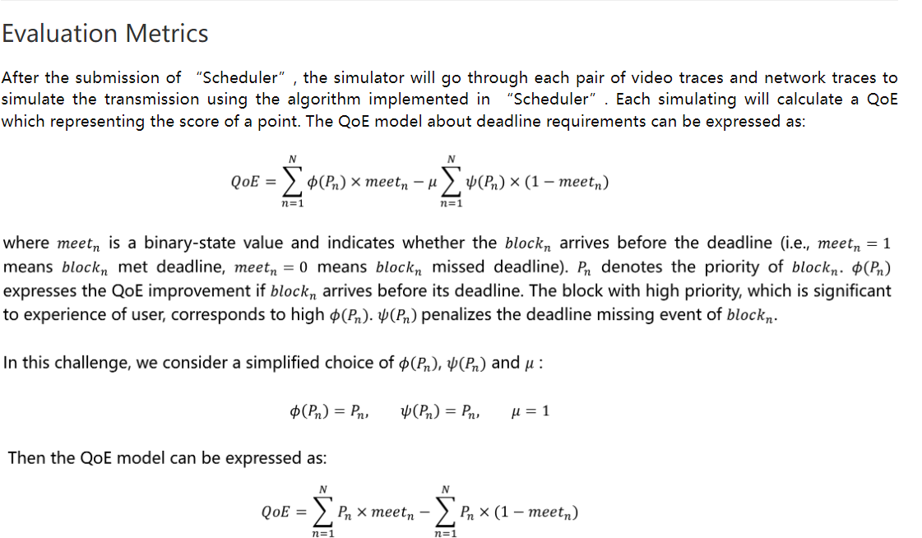
Evaluations
Pn for meeting the deadline -Pn otherwise

Slide 10
Additional Resources
Grand Challenge paper
Paper that won the first award
Simply reproducing the algorithm will result in zero score
Basics
TCP Reno (congestion control algorithm)
Simulation
Emulator class explained
Instantiation details

Slide 11
File Structure and Self Test
Clone or fork this https://github.com/ShengMingTang/Meet-Deadline-Requirements-Challenge
Put everything you need under CS5700/

Slide 12
Submission Details
Students must implement it in python
Learn if you are not familiar with
Details will be released later formally
Solution class naming
Virtual environment, module import
Path specification (model file, self-define module, …)
Computing resources and time limit for making decision
Test scripts will be open later for self-test

